Slide 1
CS1 with a Side of AI:
Teaching Software Verification for Secure Code
in the Era of Generative AI
In-class Activities
(10-15 minutes each)
Amanda Fernandez, University of Texas at San Antonio
Kimberly Cornell, University at Albany SUNY

Slide 2
INSTRUCTIONS for instructors ———————————
A recommended script is included in the speaker notes for each slide, beginning with slide 4.
Engage the audience wherever possible.
Be open to Q&A, if/as time permits.

Slide 3
CS1 with a Side of AI: Teaching Software Verification for Secure Code in the Era of Generative AI
Position: CS students need to know how to interact with LLMs and understand how to critically verify any code generated.
LLM activities (10-15 min in-class):
Introductory *need Google account
Goal: Learn to use LLM as a tutor.
Create code with variables, conditionals, loops.
Evaluate - copy/paste into IDE to verify the code compiles & runs.
Prompt engineering
Goal: Learn guidelines to prompt effectively.
Create basic methods.
Evaluate - verify the method does what it is supposed to do.
Verification
Goal: Learn steps to verify the code.
Create code with arrays & methods.
Evaluate - write out the steps in practice.
Practice
Goal: Learn to independently decide when to use the LLM and how to prompt it.
Review all course content.
Evaluate - write out the experience.
Notes:
General outline of the 4 activities (in-class).
From our SIGCSE 2024 paper:
“Our position is as follows:
As AI-generated code becomes the norm for professional developers, CS education needs to shift to incorporate these new tools.
However, redirecting the focus of CS1 courses to more abstract concepts using LLMs can lead to less-secure code generation and novice programmers dealing mainly with black boxes.
Instead, students need to know not only how to interface with the tools but also how to critically verify the code generated for them.”

Slide 4







CS1 “with a side of AI”
Artificial intelligence (AI) is everywhere these days!
It can even help you code!
…but you need to be careful!
These activities will introduce you to LLMs, & establish best practices for programming with them.
ONLINE SURVEY
Participation will not be reflected in your course grades!
Notes:
“Who are you and why are you here??”
Hi! My name is Dr. ______ and I am part of a collaborative team of Computer Science researchers and instructors from UTSA, UAlbany, and Texas State.
Our research effort is affectionately called “CS1 with a side of AI”, and our goal is to introduce you to large language models (LLMs), providing you with an understanding of how they work, in order to be able to effectively and securely use them for programming tasks, here in CS1 and beyond.
If you would take the time to participate in our online survey, we would greatly appreciate your feedback. Please look for 1 more (shorter!) survey toward the end of the semester as well.
We’ll only survey you twice.
We collect this data in order to assess how impactful this information and the AI tools in general are on your CS/programming education.
Please note that these surveys and participation in our study are not a requirement of this course and in no way affect your grades. It is completely voluntary.
If you have any questions at all during this semester about our work, please reach out to any member of our team.

Slide 5
Activity 1:
Introduction to AI / LLMs
Notes:
So, that’s who I am, let’s start in on our first activity: introduction to Artificial Intelligence & large language models (LLMs)
By a show of hands, how many here have already used LLMs like ChatGPT?

Slide 6


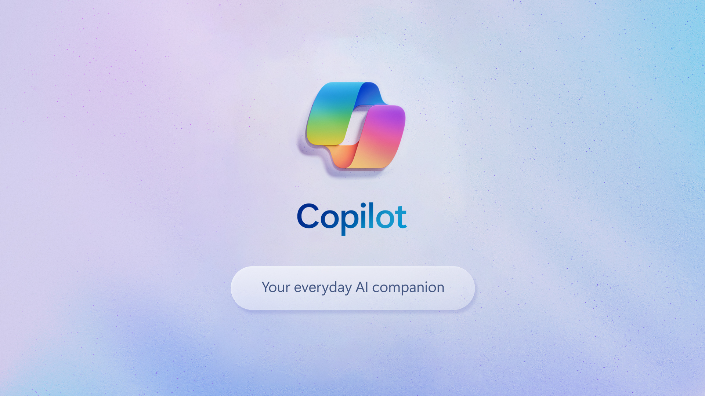
Did you know
You have a personal tutor!
Large language models (LLMs) are generative artificial intelligence agents capable of conversation.
Trained on 65 trillion tokens (words or phrases)
Generate responses, images, video, or code!
Now available in most programming environments.
Notes:
Whether or not you have experience, did you know that you have a free personal tutor for all of your classes??
They have impressive capabilities AND they’re free!
You know what they say about free stuff though, right? If the product is free, you are the product.
Everything you type or upload - assume they are watching (and saving!) your information. All of it.
For learning/education tasks, this really isn’t an issue though. AND there are no stupid questions, so ask away! Day or night, 24/7/365..
We want you to leverage these tools because we see how prolific they are becoming on the job - these agents are integrated into development environments (you all use Dr. Java to code, right? The environments on the job might be Eclipse or IntelliJ, and they have CoPilot)

Slide 7
AI as a Tutor for CS1 (in Java!)
Ask an LLM:
How do I declare and initialize a variable in Java?
What are the different data types for variables in Java?
What are logical operators like && and ! used for?
What is the difference between public, private, and protected access modifiers?
Notes:
These models are extremely well trained.
You can ask it for basic facts, but we wanted to demonstrate how they are particularly useful in computer science.
Learning a new topic? Ask an LLM!
Even CS1 - it can help you review, prepare for tests, and go beyond the course!

Slide 8
AI as a Tutor for Computer Science
Ask an LLM:
Generate practice questions for a course on Data Structures in C.
I haven’t taken Algorithms yet, can you summarize that course?
How can I prepare for an interview for my first software engineering internship?
What can I do to prepare for my first cybersecurity class next semester?
Notes:
Beyond CS1, these tools will still be useful, and even more so as they continue to improve.

Slide 9
Let’s do this!
Open a browser
Go to http://gemini.google.com
Ask the LLM to generate code
Copy & paste it into your IDE
What went wrong?
Did the code compile?
Does it work correctly?
Notes:
OK, let’s try an experiment - open a browser and go to this site.
Ask the LLM to generate some code - any code! Think of something and just type it in.
(do it together - slowly walk through getting to the website, entering a prompt, etc)
What did you get out?
(Engage the audience, asking what they asked the LLM for, whether or not they got what they wanted/expected)

Slide 10
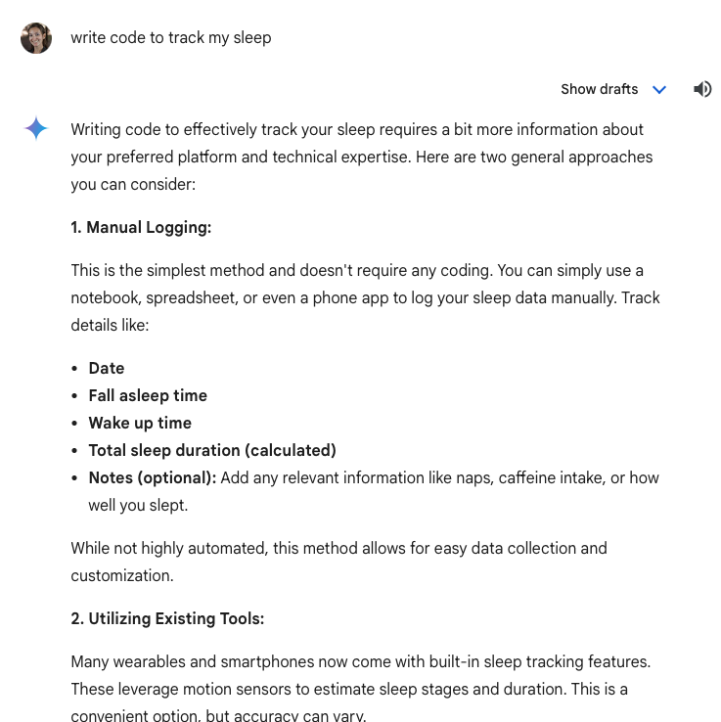
Let’s do this!
write code to track my sleep
Open a browser
Go to http://gemini.google.com
Ask the LLM to generate code
Copy & paste it into your IDE
What went wrong?
Did the code compile?
Does it work correctly?
Notes:
If we aren’t specific, the LLM won’t do exactly what we were hoping for.
Example - I asked “write code to track my sleep”
If I asked you to do this, you’d have questions too! What language? What data do you have? What format? …

Slide 11
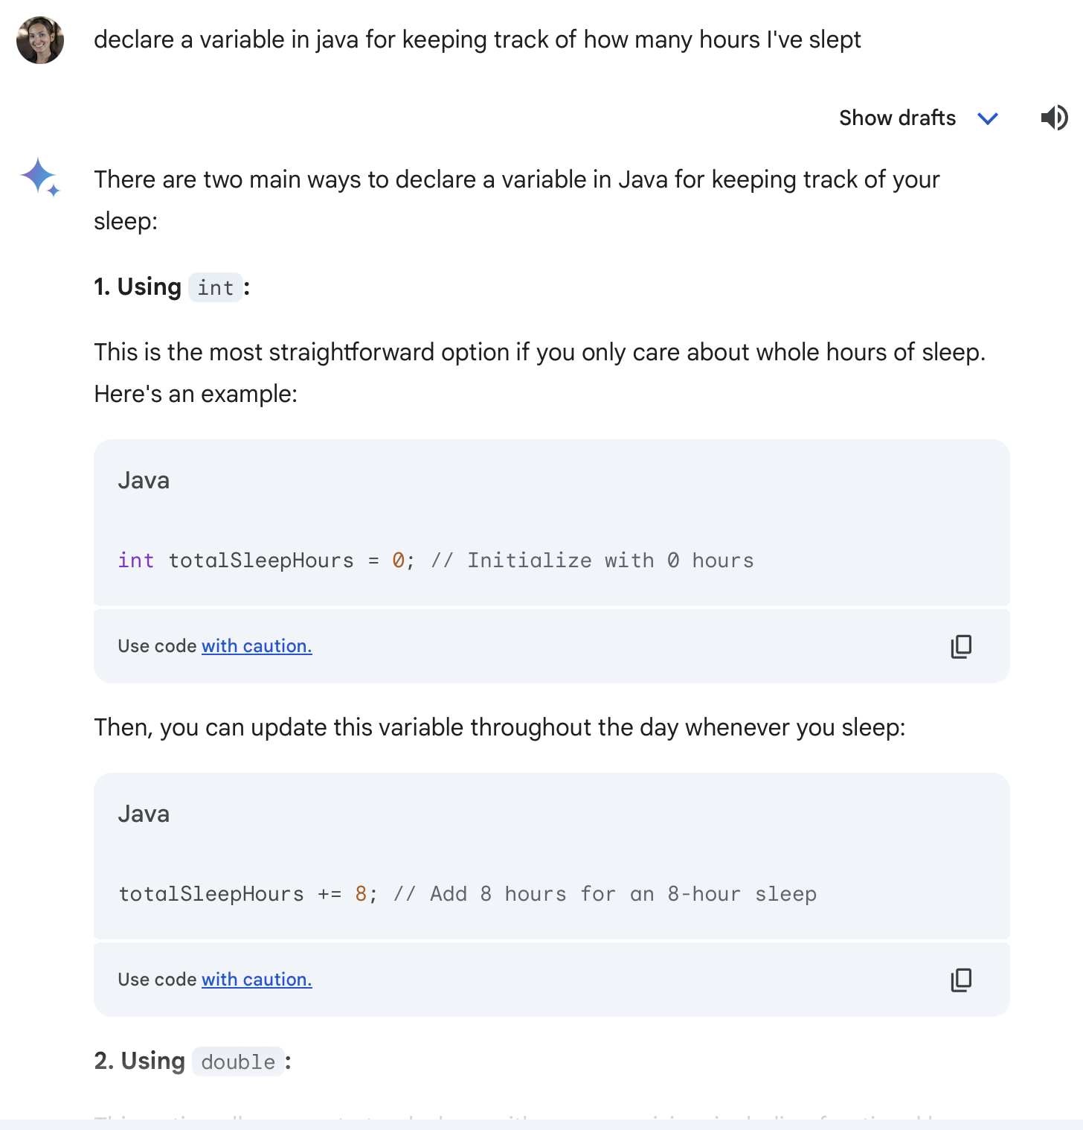
Let’s do this!
declare a variable in java for keeping track of how many hours I've slept
Open a browser
Go to http://gemini.google.com
Ask the LLM to generate code
Copy & paste it into your IDE
What went wrong?
Did the code compile?
Does it work correctly?
Notes:
If we use more specific language though - telling it to declare a variable in Java for example - we should get code in the response.
And that’s the trick - we get out what we put in.
If you’re specific, you will generally receive high quality responses.
(If you have time, go back to the LLM and generate code with loops - examples:
“Write code to count to 10 in Java”
“Write Java code to find all of the prime numbers between 0 and 100”)

Slide 12
Wrap up
Activity 1 goal: learn to use LLMs as a tutor for computer science.
Looking ahead: in 3 future activities we’ll cover:
“Prompt engineering” to get better responses from the LLM
“Software verification” to ensure we’re being safe about generated code
Practice!
Notes:
That’s what we’ll focus on in these very short activities.
I’ll come back a few more times to talk about how to do “prompt engineering” to get better responses, and “software verification” techniques to be sure we are safe about generated code.

Slide 13
Q&A
Notes:
Ask me anything!
Thank you for your time, and please consider participating in our survey!

